Slide 1
ARTIFICIAL INTELLIGENCE PROJECT REPORT 1
TEAM MEMBERS:
BHARGAV ROY 18BCE0310
ELIO JORDAN LOPEZ 18BCE2040
TOPIC: SELF DRIVING CARS USING DEEP LEARNING (OPENCV)
SUBMITTED TO: DR. PREETHA EVANGELINE D.

Slide 2
One of the main tasks of any machine learning algorithm in the self-driving car is a continuous rendering of the surrounding environment and the prediction of possible changes to those surroundings. These tasks are mainly divided into four sub-tasks:
Object detection
Object Identification or recognition Object classification
Object localization and prediction of movement
Machine learning algorithms can be loosely divided into four categories: regression algorithms, pattern recognition, cluster algorithms and decision matrix algorithms.

Slide 3
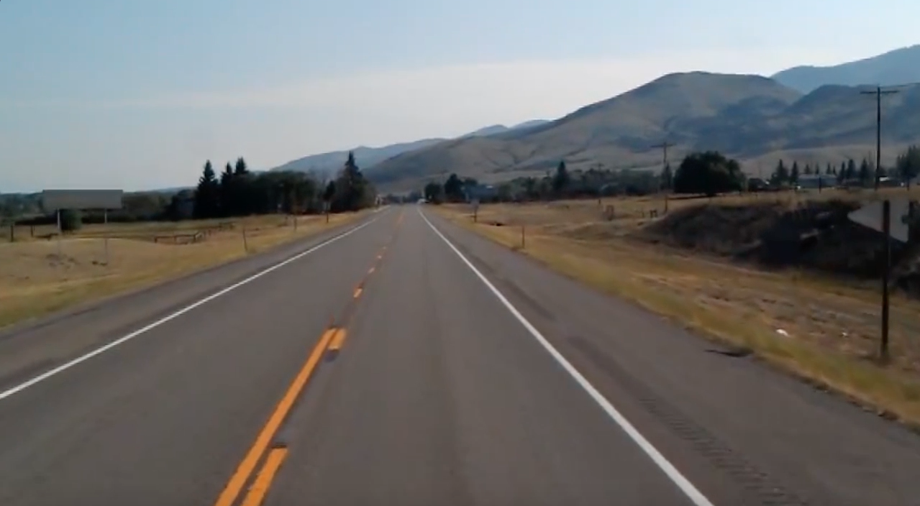
Work done so far:
Loading an Image:

Slide 4
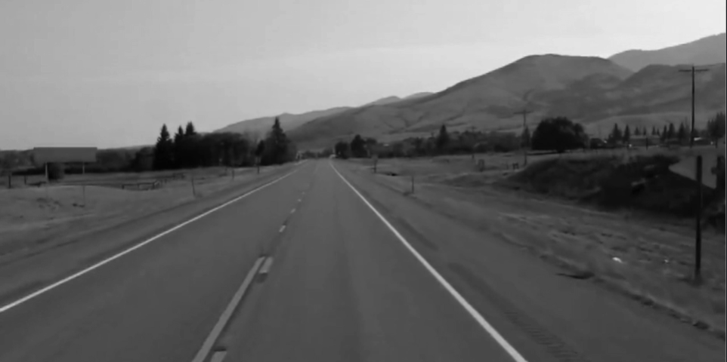
Gray-Scale Conversion of the Object:
gray = cv2.cvtColor(img, cv2.COLOR_RGB2GRAY)

Slide 5
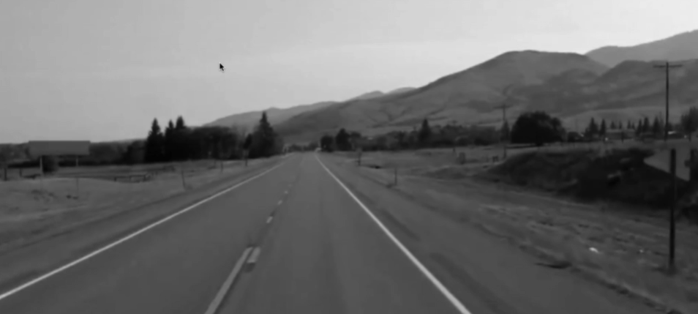
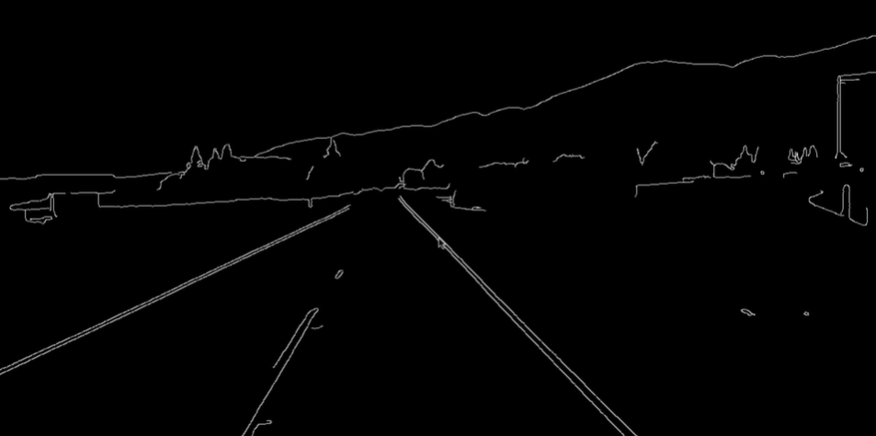
Noise Reduction: Edge Detection:
def canny(img):
gray = cv2.cvtColor(img, cv2.COLOR_RGB2GRAY)
kernel = 5
blur = cv2.GaussianBlur(gray,(kernel, kernel),0)
canny = cv2.Canny(gray, 50, 150)
return canny

Slide 6
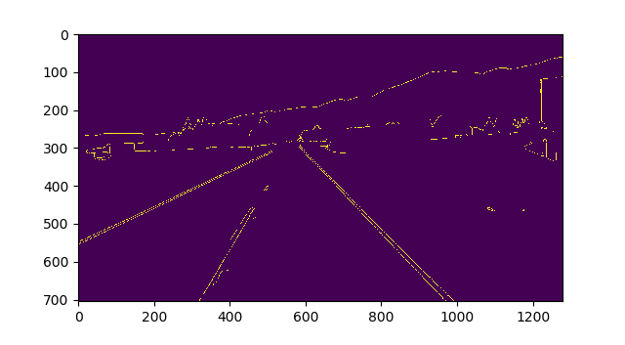

Extracting the region of interest:
def region_of_interest(canny):
height = canny.shape[0]
width = canny.shape[1]
mask = np.zeros_like(canny) make entire image black
triangle = np.array([[
(200, height),
(550, 250),
(1100, height),]], np.int32) extract the ROI and convert to white
cv2.fillPoly(mask, triangle, 255)

Slide 7

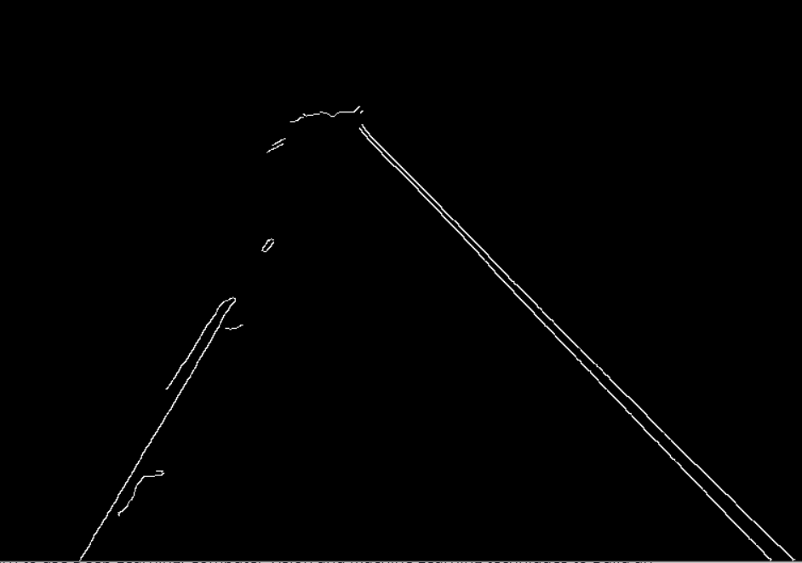
Bitwise And Operation on CANNY & MASK image to obtain a line image of the road:
& =
masked_image = cv2.bitwise_and(canny, mask) bitwise & operator only white &white gives white
return masked_image

Slide 8
Line Detection using Hough Transform
lines = cv2.HoughLinesP(cropped_canny, 2, np.pi/180, 100, np.array([]), minLineLength=40,maxLineGap=5)
It means that in general, a line can be detected by finding the number of intersections between curves.The more curves intersecting means that the line represented by that intersection have more points. In general, we can define a threshold of the minimum number of intersections needed to detect a line.
It keeps track of the intersection between curves of every point in the image. If the number of intersections is above some threshold, then it declares it as a line with the parameters (θ,rθ) of the intersection point.
# Standard Hough Line Transform
lines = cv.HoughLinesP(dst, 1, np.pi / 180, 150, None, 0, 0)
dst: Output of the edge detector. It should be a grayscale image (although in fact it is a binary one)
lines: A vector that will store the parameters (r,θ) of the detected lines
rho : The resolution of the parameter r in pixels. We use 1 pixel.
theta: The resolution of the parameter θ in radians. We use 1 degree (CV_PI/180)
threshold: The minimum number of intersections to "*detect*" a line
srn and stn: Default parameters to zero.

Slide 9
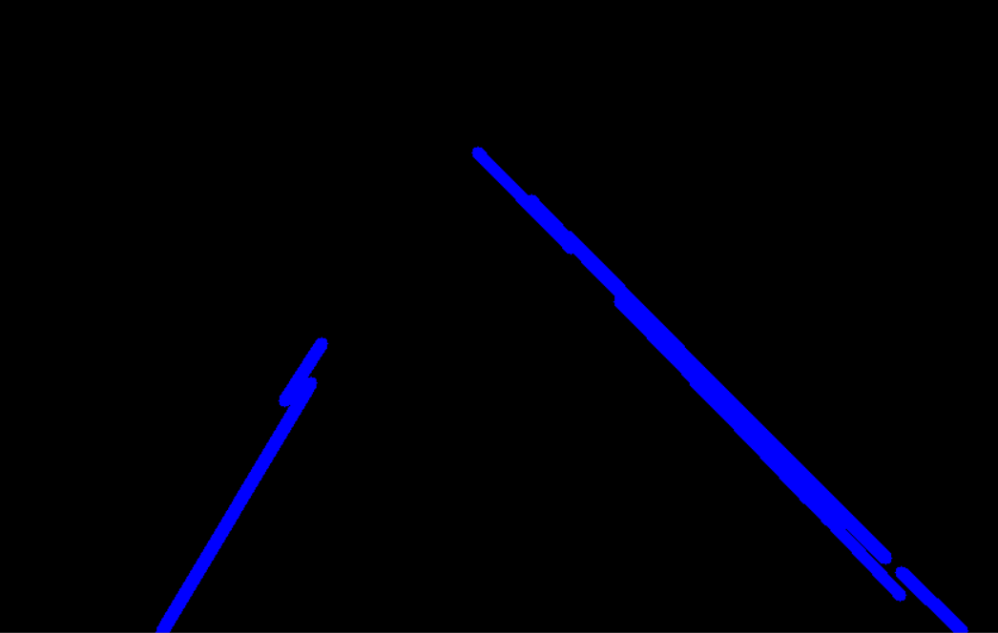
Result of applying OpenCV’s Hough Transform on the collection of intersecting lines:
We obtain the slopes and intercepts of the right_fit
(positive slope)
Y axis
We obtain the slopes and intercepts of the left_fit (negative slope)
X axis

Slide 10
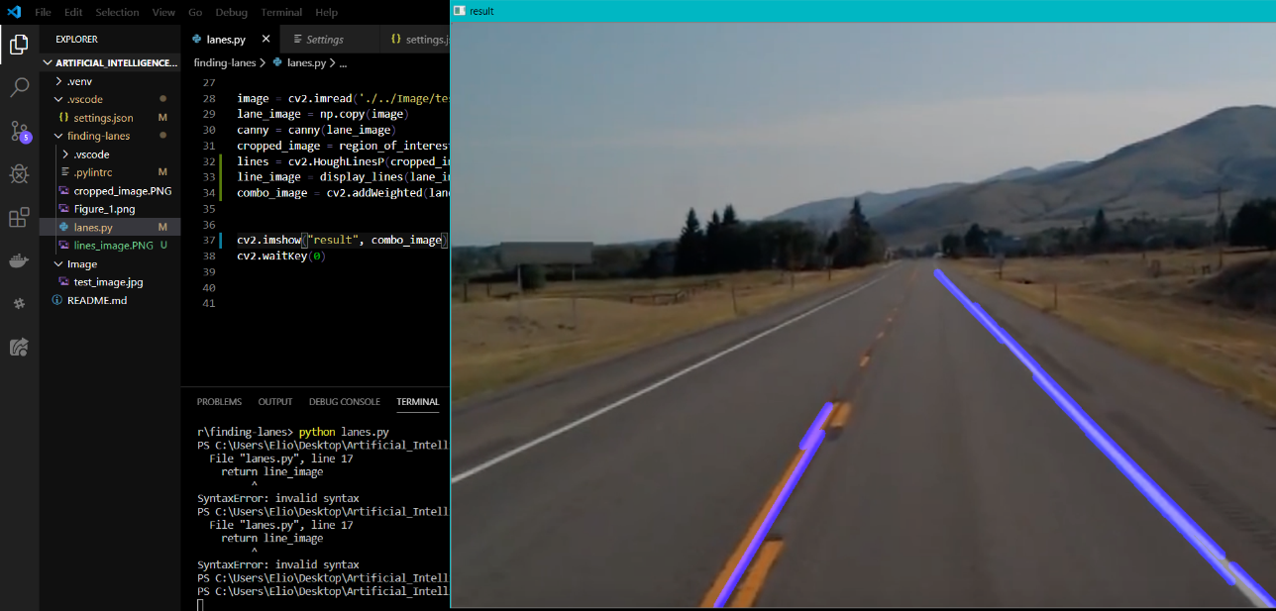
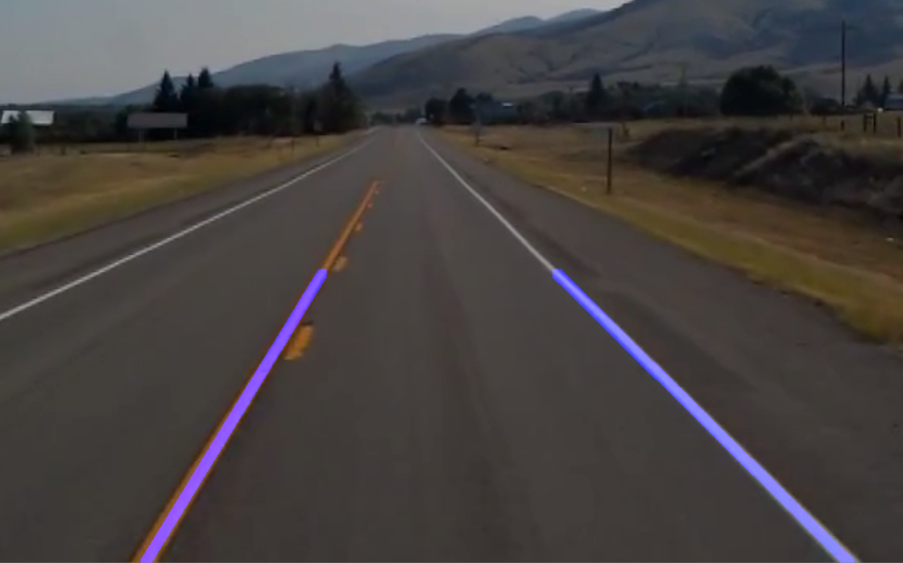
We obtained an average line from the two broken lines (two continuous lines by applying an averaging function):
def make_points(image, line):
slope, intercept = line
y1 = int(image.shape[0])# bottom of the image
y2 = int(y1*3/5) # slightly lower than the middle
x1 = int((y1 - intercept)/slope)
x2 = int((y2 - intercept)/slope)
return [[x1, y1, x2, y2]]
def average_slope_intercept(image, lines):
left_fit = []
right_fit = []
if lines is None:
return None
for line in lines:
for x1, y1, x2, y2 in line:
fit = np.polyfit((x1,x2), (y1,y2), 1)
slope = fit[0]
intercept = fit[1]
if slope < 0: # y is reversed in image
left_fit.append((slope, intercept))
else:
right_fit.append((slope, intercept))
# add more weight to longer lines
left_fit_average = np.average(left_fit, axis=0)
right_fit_average = np.average(right_fit, axis=0)
left_line = make_points(image, left_fit_average)
right_line = make_points(image, right_fit_average)
averaged_lines = [left_line, right_line]
return averaged_lines

Slide 11
FOR THE UPCOMING REVIEWS, WE WILL WORK ON PREDICTIVE ANALYSIS:
Regression Algorithms: The challenge is to develop an image-based model for prediction and feature selection. Ex: neural network regression
Pattern Recognition Algorithms (Classification): Aid in reducing the data set by detecting object edges and fitting line segments (polylines) and circular arcs to the edges.
Clustering: All methods are concerned with using the inherent structures in the data to best organize the data into groups of maximum commonality.
Decision Matrix Algorithm: Whether a car needs to take a left turn or it needs to brake depends on the level of confidence the algorithms have on the classification, recognition, and prediction of the next movement of objects. These algorithms are models composed of multiple decision models independently trained and whose predictions are combined in some way to make the overall prediction while reducing the possibility of errors in decision making. The most commonly used algorithms are gradient boosting (GDM).

